Slide 1
Chapter 9
Confidence Intervals: Admitting that Estimates Are Not Exact
Elsevier/Academic Press
© Andrew F. Siegel, 2016

Slide 2
Overview
Confidence Interval
  Computed from data
  Has a known probability of including the unknown population parameter being estimated
Statistical Inference
  An exact probability statement about the population, based on sample data
Confidence Level
  The probability of including the population parameter within the confidence interval
    95% is the usual standard. Also: 99%, 99.9%, 90%
Elsevier/Academic Press
© Andrew F. Siegel, 2016

Slide 3
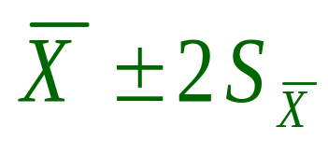
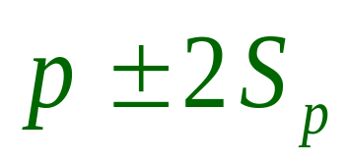
Approximate Confidence Interval
Estimator ± 2(Standard error of estimator)
  We are 95% sure the population parameter is in this interval
For population mean:
For population percentage (binomial):
Because an estimator (if normally distributed) has a 95% chance of being within two of its standard deviations from its mean. [For 95%: 1.960 SDs is approximately 2]
These must match
Elsevier/Academic Press
© Andrew F. Siegel, 2016

Slide 4








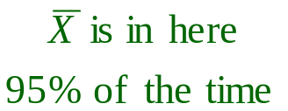
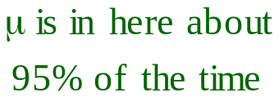
Why does it work?
is within of its mean μ about 95% of the time
  Because is an estimator of (the standard deviation of the sampling distribution of )
This also says that μ is within of about 95% of the time
μ
μ
Elsevier/Academic Press
© Andrew F. Siegel, 2016

Slide 5
Here is what you really see!
Elsevier/Academic Press
© Andrew F. Siegel, 2016

Slide 6
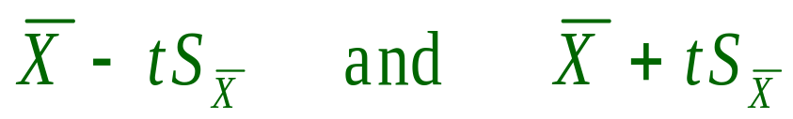


Confidence Interval for the Mean
We are 95% sure that the unknown population mean μ is between
where t is the critical t value
For finite sample sizes
  t is larger than 1.960 (approximately 2, for normal dist)
    Because we used the Standard Error ( ) as an estimator in place of the Population Standard Deviation ( ) of the sample average
Elsevier/Academic Press
© Andrew F. Siegel, 2016

Slide 7
Some Critical t Values for Large Samples
For large sample sizes, here are some critical t values for two-sided confidence intervals:
  t = 1.959964 for 95% confidence
  t = 2.575829 for 99% confidence
  t = 3.290527 for 99.9% confidence
For large sample sizes, here are some critical t values for one-sided confidence intervals:
  t = 1.644854 for 95% confidence
  t = 2.326348 for 99% confidence
  t = 3.090232 for 99.9% confidence
Elsevier/Academic Press
© Andrew F. Siegel, 2016

Slide 8

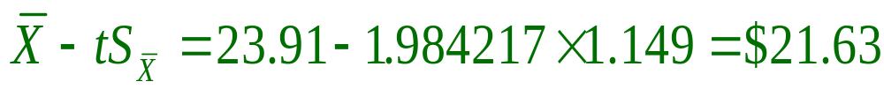
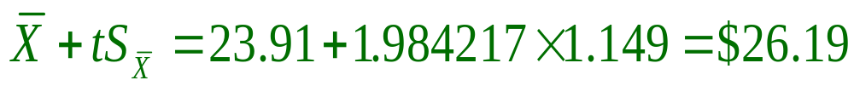
Example: Restaurant Survey
  n = 100 residents
  = $23.91 average expenditures
  S = $11.49 variability of individuals
  = $1.149 variability of the sample average
  t = 1.984217 critical t value, 2-sided 95% confidence, n = 100
From
To
We are 95% sure that the unknown population mean expenditure μ is between $21.63 and $26.19 for all
N = 77,386 residents in the population
  Even though we only observed 100 people!
Elsevier/Academic Press
© Andrew F. Siegel, 2016

Slide 9

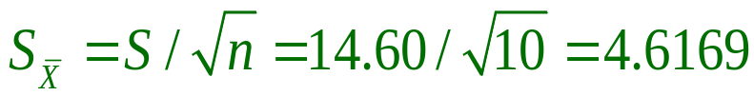
Example: Medical Production
Production of a new drug for heart attack treatment
    n = 10 production runs
    = 68.30 grams produced
    S = 14.60 grams
Yearly budget needs to know about
    • μ = mean production rate of the process
95% confidence interval calculation
  t = 2.262157 critical t value, 2-sided 95% confidence, n = 10
  From
  To
Elsevier/Academic Press
© Andrew F. Siegel, 2016

Slide 10
Example (continued)
Confidence interval statement
  We are 95% sure that the unknown mean production rate μ is between 57.86 and 78.74 grams per production run
  This tells you what is likely to happen in the future, if there are many more production runs like the ones in the sample
    The confidence interval reflects the uncertainty due to variability from one production run to another
  The interval does not reflect uncertainty due to other causes (e.g., future improvements in the process)
Elsevier/Academic Press
© Andrew F. Siegel, 2016

Slide 11


Example (continued: 99%)
Using the 99% confidence level
  t = 3.249836 critical t value, 2-sided 99% confidence, n = 10
  From
  To
99% confidence
95% confidence
50
60
70
S = 14.6
80
90
Grams produced
We use the standard
error (not S) because
the confidence interval
is for the mean
Elsevier/Academic Press
© Andrew F. Siegel, 2016

Slide 12

Assumptions
Assumptions needed for validity of the Confidence Interval
  1. Data are a RANDOM SAMPLE from the population of interest
    (So that the sample can tell you about the population)
  2. The sample average is approximately NORMAL
    Either the data are normal (check the histogram)
    Or the central limit theorem applies:
      Large enough sample size n, distribution not too skewed
    (So that the critical t value is technically appropriate)
Elsevier/Academic Press
© Andrew F. Siegel, 2016

Slide 13
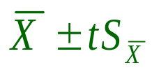
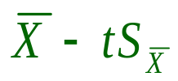
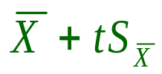
Interpretation
Interpreting a Confidence Interval
  Population mean μ is fixed and unknown
  Confidence interval is random and known
  The probability is 0.95 that μ is between
  and
  We are 95% sure that (for example) μ is between
  57.86 and 78.74
  Lifetime average: about 95% of confidence intervals included μ.
    You may never know which ones!
For random
variables
For numbers
Elsevier/Academic Press
© Andrew F. Siegel, 2016

Slide 14
Imagine Many Samples
Other intervals you
might have computed
Missed!
Missed!
The interval you computed
22
23
24
The population mean μ = 23.29
Elsevier/Academic Press
© Andrew F. Siegel, 2016

Slide 15
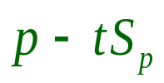
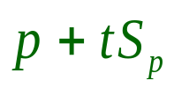
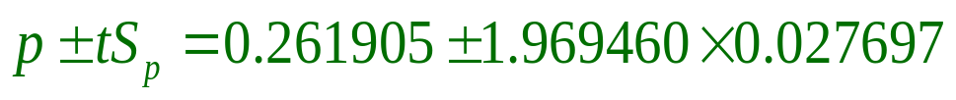
Binomial Confidence Interval
From to for large n
Example: X = 66 out of n = 252 interviewed said they would buy the product
• π = ? = percent of population who would have said that they would buy the product
p = 66/252 = 0.261905, or 26.2%, is the sample proportion
  An estimate of π
  Indicates the uncertainty in p
Confidence interval:
We are 95% sure that π is between 20.7% and 31.6%
Critical t
value for
n = 268
Elsevier/Academic Press
© Andrew F. Siegel, 2016

Slide 16
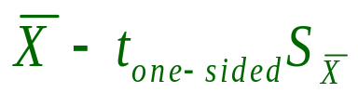
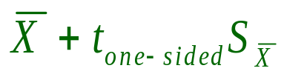
One-Sided Confidence Interval
Fig 9.4.1
Choose one:
  We are 95% sure that the population mean is at least as large as
  Or: We are 95% sure that the population mean is not larger than
Where t is the one-sided critical t value
95% one-sided
…
…
95% one-sided
90% two-sided
95% two-sided
Standard error
Sample average
Elsevier/Academic Press
© Andrew F. Siegel, 2016

Slide 17
One-Sided Criterion
Fig 9.4.1
Criterion for using a one-sided confidence interval
  No matter how the data had come out you would still have used a one-sided interval on the same side (“at least” or “no larger than”).
  If, had the data come out differently, you might have used a one-sided interval on the other side, you should use a two-sided interval instead.
  If you ignore this criterion, you may have only 90% confidence when you claim 95% confidence.
Elsevier/Academic Press
© Andrew F. Siegel, 2016

Slide 18

Example: Medical Production
Production of a new drug for heart attack treatment
    n = 10 production runs
    = 68.30 grams produced
    S = 14.60 grams
Yearly budget needs to know about
    • μ = mean production rate of the process
99% one-sided confidence interval calculation
  t = 2.821438 critical t value, 1-sided 99% confidence, n = 10
  We are 99% sure that the mean production rate μ is at least 55.27
Compare to 99% 2-sided 53.30 to 83.30
Elsevier/Academic Press
© Andrew F. Siegel, 2016

